Slide 1

📰 News Article RAG System
Retrieval-Augmented Generation (RAG) using news dataset
NEVIL ITALIYA

Slide 2
AGENDA
Overview
Dataset & Preprocessing
System Architecture
Agent Overview
Core Technologies
Live Demo / Workflow
Design Decisions
Challenges & Solutions
Future Work
Q&A

Slide 3
SYSTEM OVERVIEW
News overload makes it hard to stay updated efficiently
Professionals need short, reliable summaries
LinkedIn creators want well-written posts from real-time topics
🧠 Summary:
We solve both problems: retrieve and summarize news, then convert it into shareable posts
Automates a real use case using AI + retrieval

Slide 4
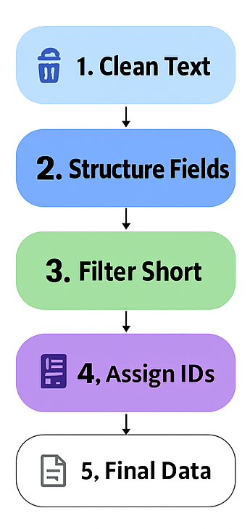
📚 DATASET & PREPROCESSING
📦 Dataset: Kaggle News Category Dataset
~200,000 news articles from HuffPost
Fields used: headline, short_description, category, link
🧹 Preprocessing Pipeline
Unicode normalization, whitespace cleanup
Generated structured field for embedding:
→ "Headline\nCategory\nSummary"
Removed empty/short entries (< 5 words)
Assigned unique ID to each row
Output: cleaned_news_final.csv
🧠 Key Takeaways:
We transformed unstructured news into a clean, searchable knowledge base
Output: cleaned_news_final.csv used for vector search

Slide 5
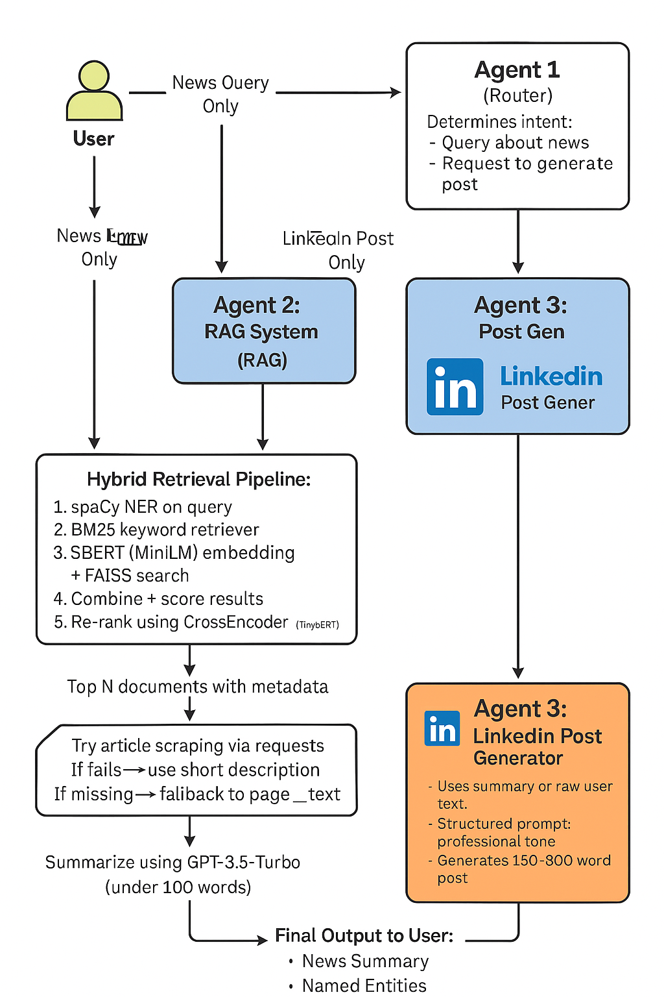
SYSTEM ARCHITECTURE

Slide 6
SYSTEM ARCHITECTURE
🧠 System in a Nutshell:
Query flows through retrieval pipeline and LLM summarizer
Agents help route between workflows (summary-only, post-only, both)
Retrieval system uses hybrid techniques + reranking for best results

Slide 7
🤖 AGENT-BASED DESIGN
Agent 1 (Router)
Decides if the user wants news, a post, or both
Agent 2 (RAG System)
Uses hybrid search (FAISS + BM25), NER boost, CrossEncoder rerank
Summarizes relevant articles with LLM
Agent 3 (LinkedIn Post Generator)
Converts content into a post using structured prompts
🧠 Flow:
Agents modularize the logic: makes it easy to scale, test, or deploy each separately
Smart routing improves UX and system efficiency

Slide 8
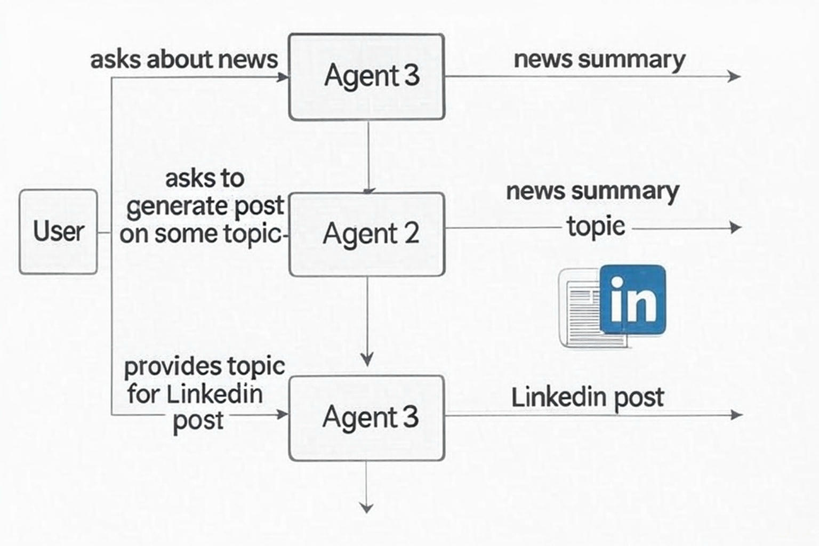

Slide 9
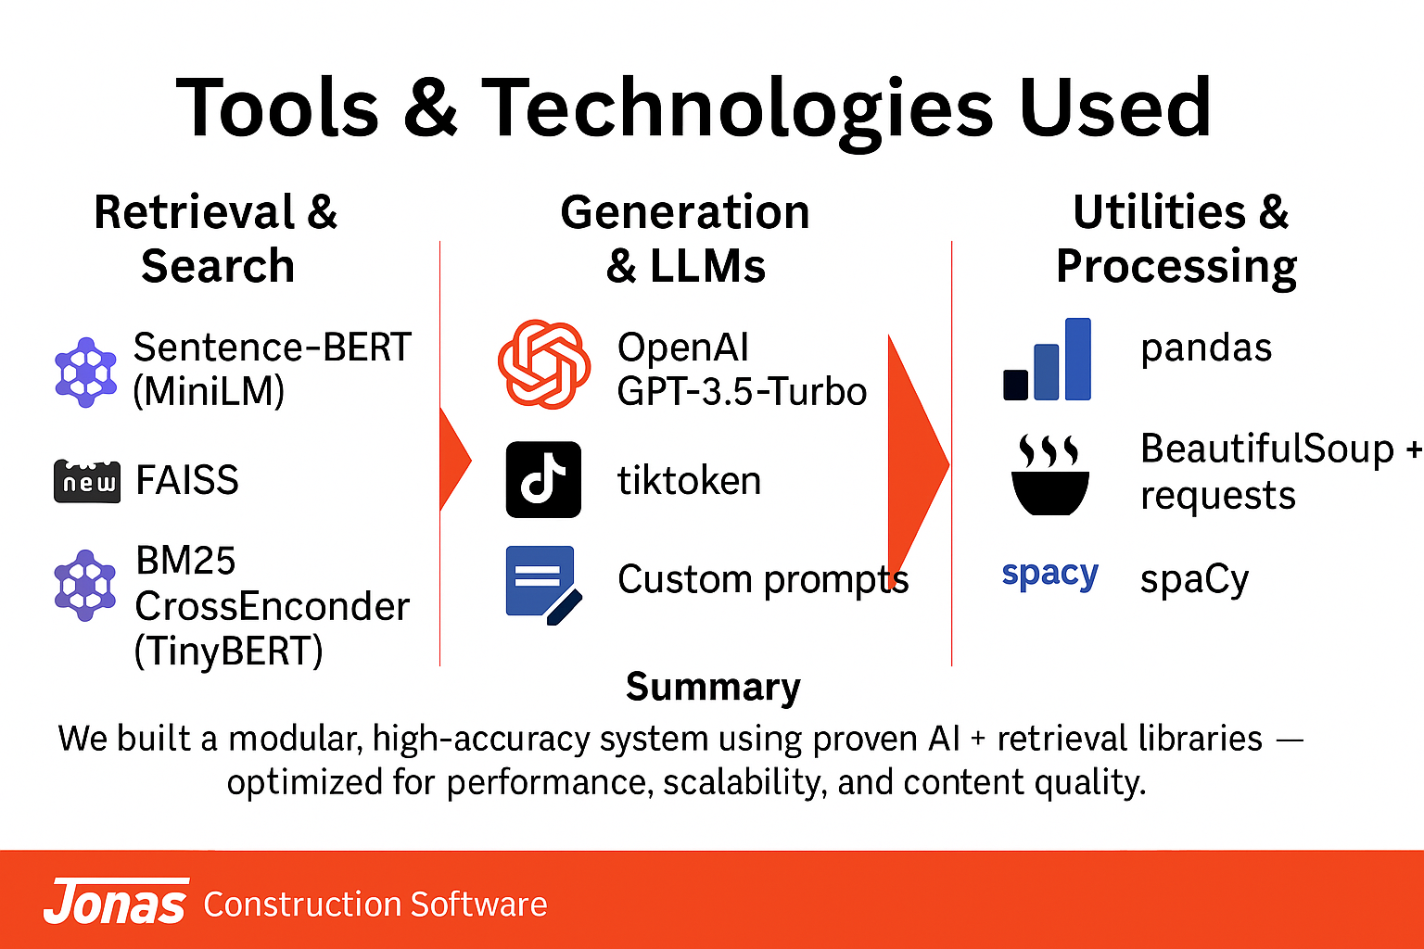



🧰 CORE TECHNOLOGIES USED

Slide 10
🖥 Live Demo Walkthrough
CLI Modes:
Ask about news (Agent 2)
Generate post from content (Agent 3)
Ask and generate post (Agent 1)
Output:
Summary (under 100 words)
NER tags
LinkedIn post
Article sources
🧠 Overall Picture:
System works as CLI or Streamlit UI
Users can interact with any agent directly

Slide 11

🧠 Design Decisions
Hybrid Search: Combines semantic (FAISS) + keyword (BM25)
NER Boosting: Entities improve doc relevance
CrossEncoder Re-ranking: Orders final results with learned relevance
Scraping & Fallback: Uses full article if link works; else short description or page content
Token Limiting: Prevents OpenAI prompt overflow
🧠 Summary:
Carefully tuned each layer for relevance, speed, and stability
Everything runs modularly to keep architecture clean

Slide 12
⚠️ Challenges & Solutions
Challenge
Long LLM prompts
Bad article links
Slow scraping
Inconsistent retrieval
Solution
Implemented token-aware trimming using tiktoken to avoid cutoff errors
Built a multi-layer fallback: scrape ➝ short description ➝ text snippet
Added in-memory caching to reduce repeated HTTP requests
Used named entity boosting + CrossEncoder reranking to improve accuracy

Slide 13
⚠️ Challenges & Solutions
Challenge
Large dataset size
Summarization drift
Latency during generation
Solution
Filtered out noisy/short entries, kept only structured, relevant articles
Added in-memory caching to reduce repeated HTTP requests
Used named entity boosting + CrossEncoder reranking to improve accuracy

Slide 14
🧰 Future Work
Area | Next-Gen Tool | Why / Benefit
Embeddings | BGE-large / e5-large/ Openai Embeddings API | Higher-quality embeddings improve semantic recall and context alignment
Re-ranking | BGE-Reranker / Mistral-Reranker | Boosts retrieval precision with smarter top-k ranking
Vector DB | Qdrant, Pinecone | Scalable, persistent, supports filtering and metadata-rich queries
LLM | GPT-4-turbo, Claude 3 Opus | More factual, fluent, and context-aware — improves summary and post generation
Framework | LlamaIndex, Haystack | Modular control over retrieval, indexing, and chunking logic

Slide 15
🙏 Thank You / Q&A
🧠 Summary:
Complete, end-to-end RAG system with LinkedIn integration
Ready for demo, deployment, or further research
GitHub: https://github.com/nevil-06/Jonas-Assessment-Project1
Email: italiya5@uwindsor.ca

